Slide 1
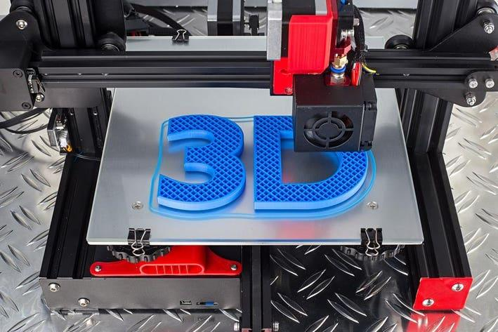
3D Design and printing
Gil Tal
Oct 2024

Slide 2


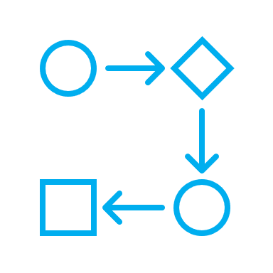
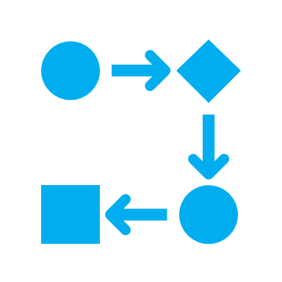


3D printing
Some background
The two main used technologies, multi-head printers
Design to print process
Design a 3D model with Fusion 360
Different printing materials
Slicer setup and printing

Slide 3

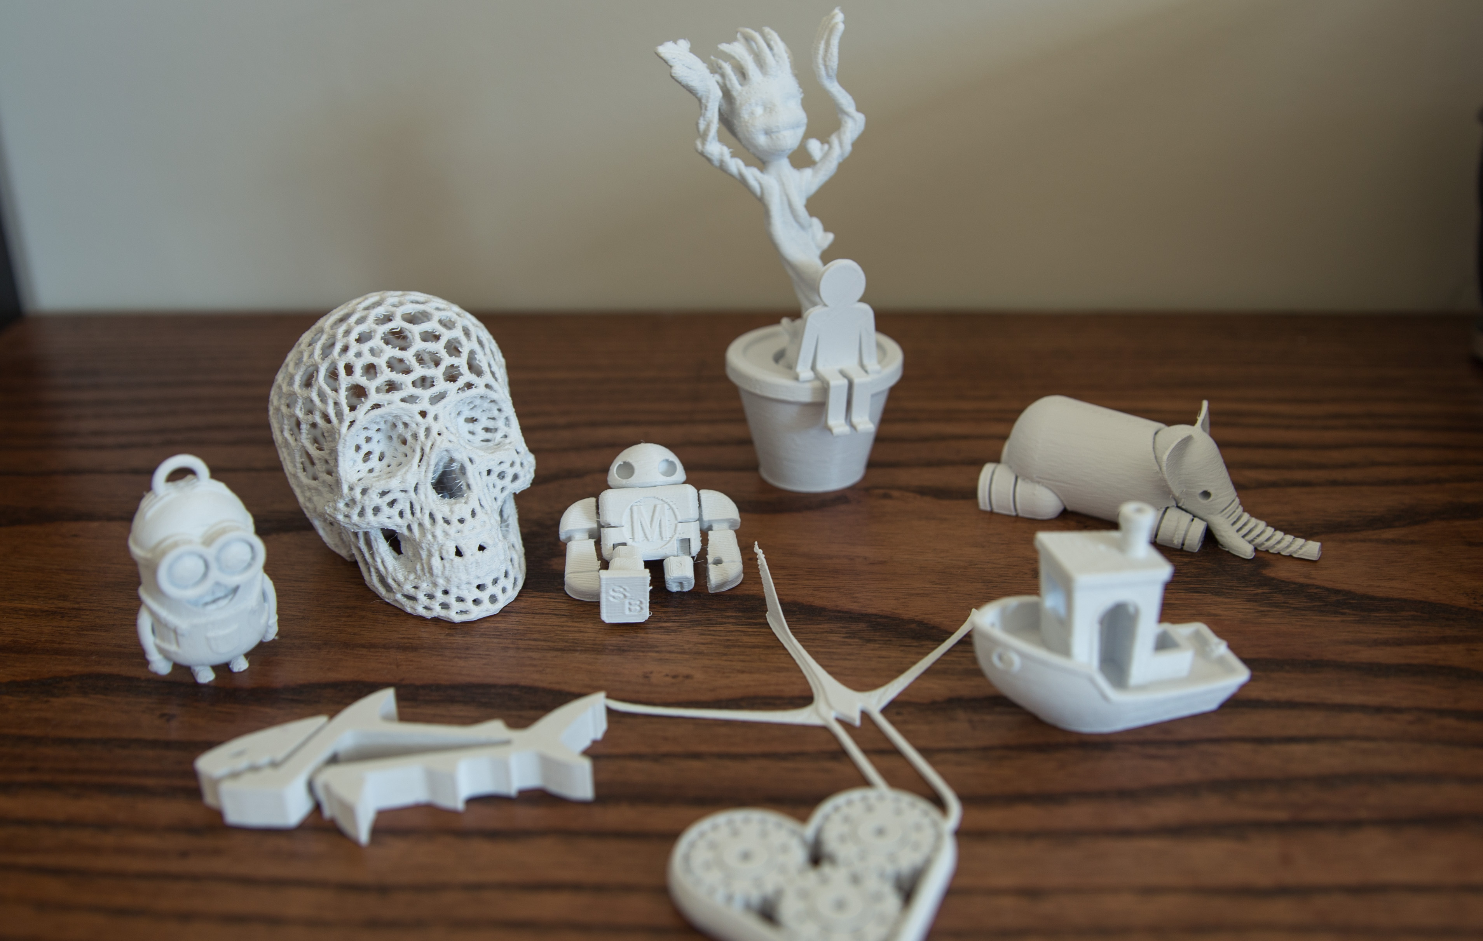
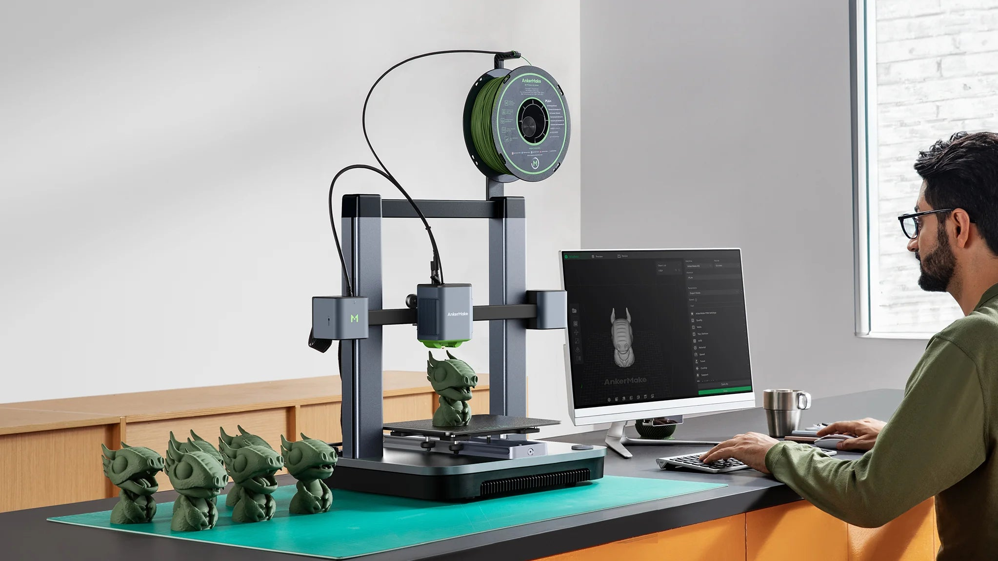
Some background…
3D printing is a process in which we take a 3D model and create a real life copy using a 3D printer
There are many types of 3D printers using very different approaches
Printing is being done layer by layer

Slide 4
Key Features of FDM 3D Printers
A FDM (Fused Deposition Modeling) printer creates objects by melting and extruding a thermoplastic filament through a heated nozzle. The printer builds the object layer by layer, with each layer fusing together as the material cools and solidifies. FDM is one of the most popular and accessible 3D printing technologies, especially for hobbyists, educational settings, and prototyping
Material Used: Thermoplastic filaments such as PLA, ABS, PETG, and others. These materials are fed into the printer as spools of filament, typically in 1.75 mm or 2.85 mm diameters
Printing Process:
The printer heats the filament to its melting point
The melted filament is extruded through a nozzle onto a print bed
The nozzle moves in a precise pattern (based on the 3D design) and deposits the material layer by layer
The object gradually forms as each layer cools and solidifies, bonding to the layer beneath it

Slide 5
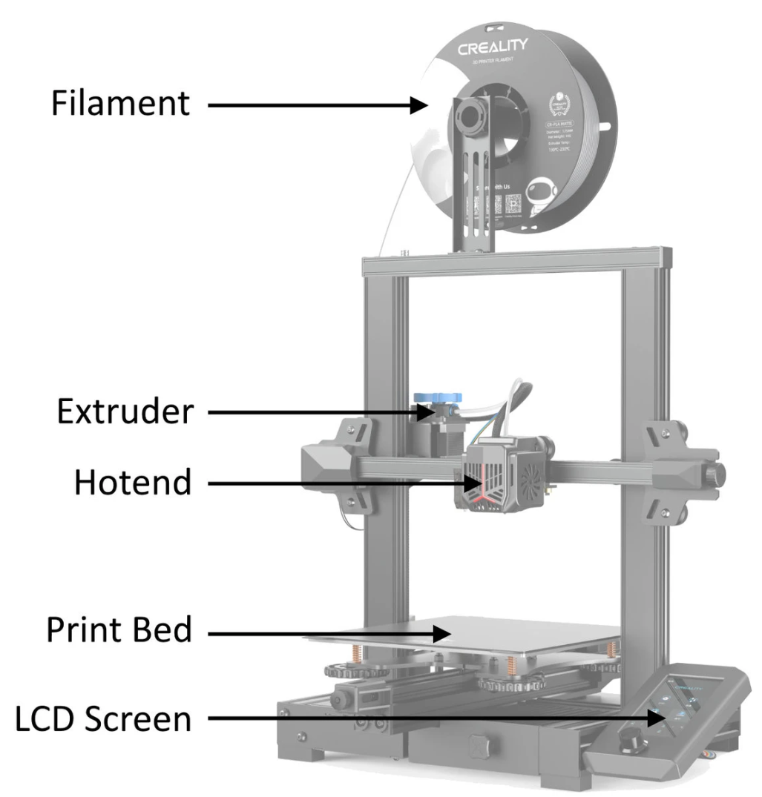
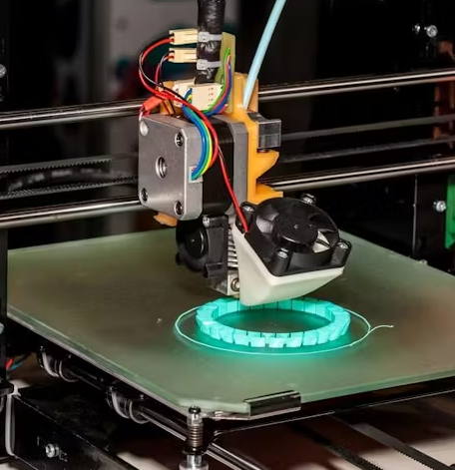

Slide 6
Key Features of Resin 3D Printers
A resin 3D printer uses liquid photopolymer resin as the printing material. The printer cures (hardens) the resin layer by layer using ultraviolet (UV) light, typically from an LED or laser, to solidify the resin. Resin 3D printers are often used for applications that require high precision and fine detail, such as jewelry design, dental models, miniatures, and prototyping
Printing Process:
Resin is stored in a vat, and the build platform of the printer is submerged in the resin
A light source (UV LED or laser) is used to selectively cure the resin layer by layer. In SLA (Stereolithography) and DLP (Digital Light Processing), the light source is directed at the resin to solidify specific areas based on the 3D model
The print bed moves incrementally (up or down) to allow the next layer of resin to be cured
This process repeats until the object is fully formed

Slide 7
Design to real world model process
Step 1: design a 3D model using a dedicated SW \ Application
Step 2: Generate an STL file or 3mf
Step 3: Slice the STL file using a printer specific slicer application
Step 4: Prepare the printer for printing (can be skipped in most new printers)
Load Filament or fill with resin
Bad leveling if needed
Step 5: Print the object
Step 6 (Not mandatory): Post processing or curing if using a resin printer

Slide 8
Design a 3D model with Fusion 360
Sketch
Essential sketch tools: Line, rectangle, circle, arcs, fillet
Extrude & Revolve
Creating complex shapes with: Loft & Sweep
Fillet & Chamfer (smooth/rounded edges)
Shell (hollowing objects)
Modifying bodies: Move, Scale (under surface), Mirror, Pattern
Boolean operations: Join, Cut, Intersect
Tapping
Combining & Editing
Tips and important considerations
Exporting 3D models

Slide 9
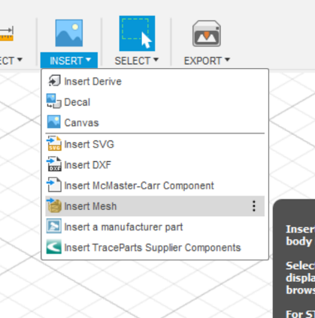
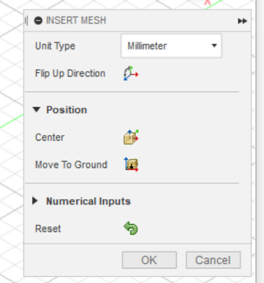
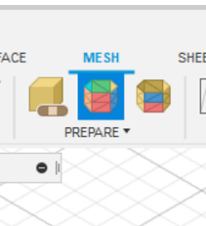
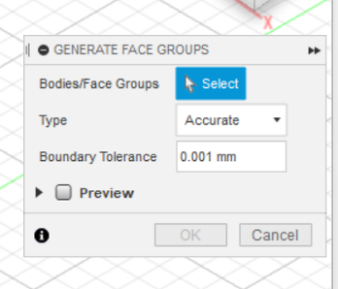
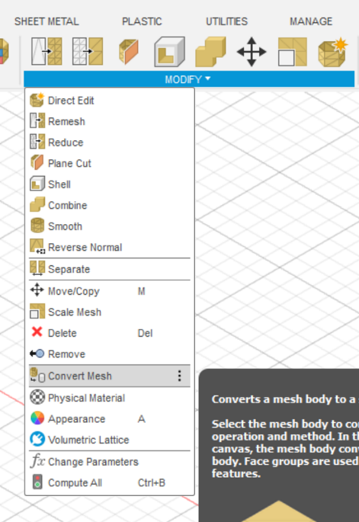
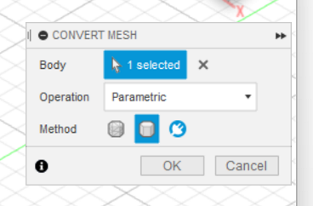
Importing an STL file for editing

Slide 10
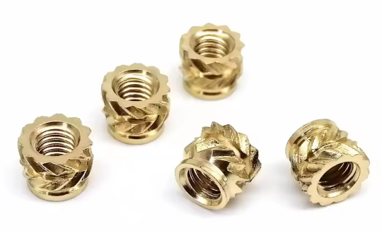
Tips and considerations
Use symmetrical design and use mirror or pattern to complete
Take into account hang overs, 45 degree is what most printers can handle without support
Avoid support as mush as possible on FDM printers
If we need much stronger threads, use Twill Knurled Thread
Storage for PLA needs attention

Slide 11
Property | PLA | LW PLA | PETG | ABS | TPU
Price 💰 | Low | Medium | Medium | Low-Medium | Medium-High
Heat Resistance 🌡️ | ~60°C (not suitable for cars) | ~60°C | ~75-85°C | ~100-110°C | ~80-95°C
Strength 💪 | Medium | Low-Medium | High | High | High (Flexible)
Flexibility | Low | Medium | Medium | Low | Very High (Rubber-like)
Ease of Printing 🎯 | Very Easy | Moderate (foaming needs tuning) | Moderate | Difficult (needs enclosure) | Moderate-Difficult
Print Temperature | 190-220°C | 190-220°C | 230-260°C | 230-260°C | 210-250°C
Bed Temperature | 0-60°C | 0-60°C | 70-90°C | 90-110°C | 40-60°C
Warping Risk 🚨 | Low | Low | Low | High | Low
Layer Adhesion | Good | Good | Excellent | Poor (without enclosure) | Excellent
Water Resistance 💦 | Poor | Poor | Good | Poor | Excellent
UV Resistance ☀️ | Poor | Poor | Good | Poor | Good
Toxicity ⚠️ | Low (Safe) | Low (Safe) | Low (Safe) | High (Fumes, needs ventilation) | Low (Safe)
Recyclability 🔄 | Biodegradable (not recyclable) | Biodegradable (not recyclable) | Recyclable | Recyclable | Not easily recyclable
Best Uses 🏆 | Prototypes, hobby prints | Lightweight parts, RC planes | Mechanical parts, food-safe | Functional, high-heat parts | Flexible parts, gaskets, grips

Slide 12
Slicer setup
Need to setup:
Print orientation for best efficiency and speed
Nozzle and bed temperatures
Print quality (layer height, speed)
Infill density
Brim for small prints
Support
Slice (generating G code for our printer)
Printing ☺
Make sure you have enough filament
Check if bed leveling is needed
Watch out for the printer at least for the first few minuets, better to have a camera to look after from our phone (look at the next slide)

Slide 13
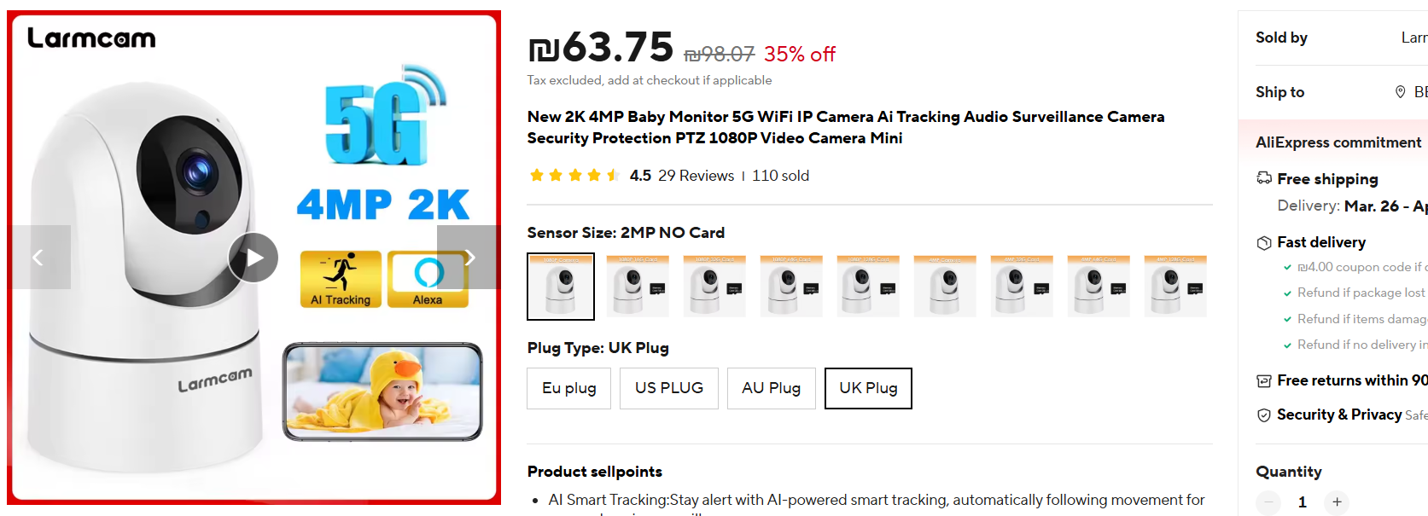
Cheap - watch from anywhere camera
https://www.aliexpress.com/item/1005002669547869.html?spm=a2g0o.order_list.order_list_main.138.5aa71802GFcsoA

